Slide 1
Expenditure Data Analysis Project
Leo RAJAN

Slide 2
Problem Statement:
• No business can survive in this competitive market without managing their cost. It does not matter if revenues are high but if cost is higher it is a red flag. So you are tasked to help management in creating and establishing new structure and models to reduce cost.
• Do ETL : Extract-Transform-Load the dataset and find for me some information from this large data. This is form of data mining.
• Interns will brainstorm to uncover the valuable insights attainable through data mining.
• Identify key metrics and factors, demonstrating meaningful relationships between attributes.
• Conduct independent research to formulate your own discoveries.

Slide 3
Benefits:
• Monitor the performance of products across all categories.
• Enhance the accuracy of financial and annual reports on a product-specific basis.
• Strategize cost management for future integration efforts.
• Drive overall performance improvement initiatives.

Slide 4
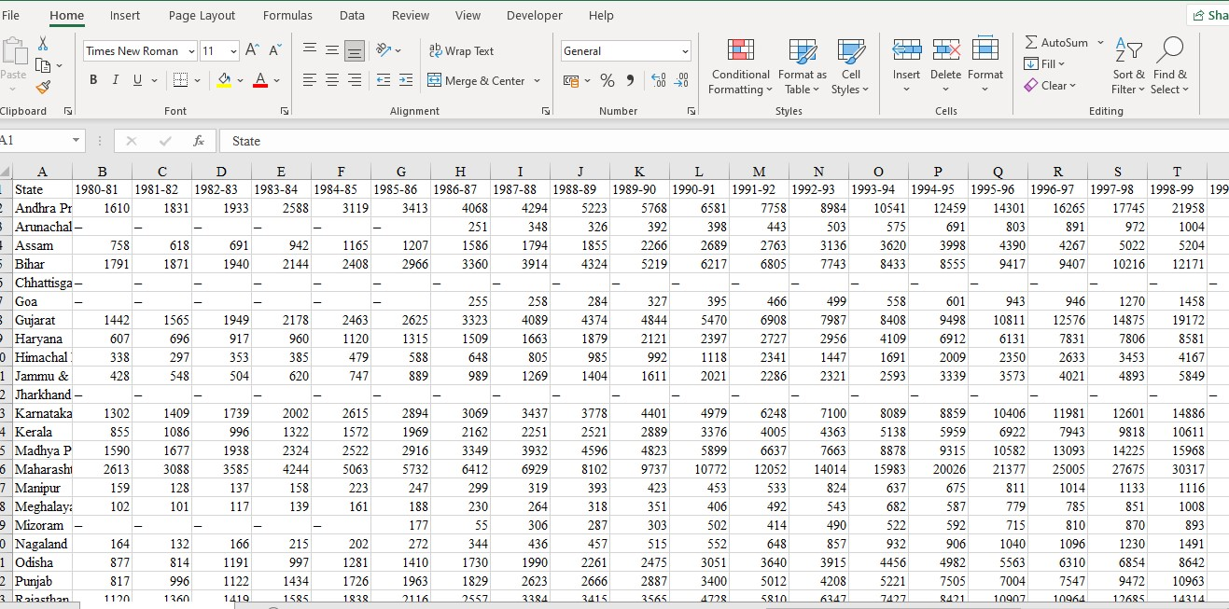
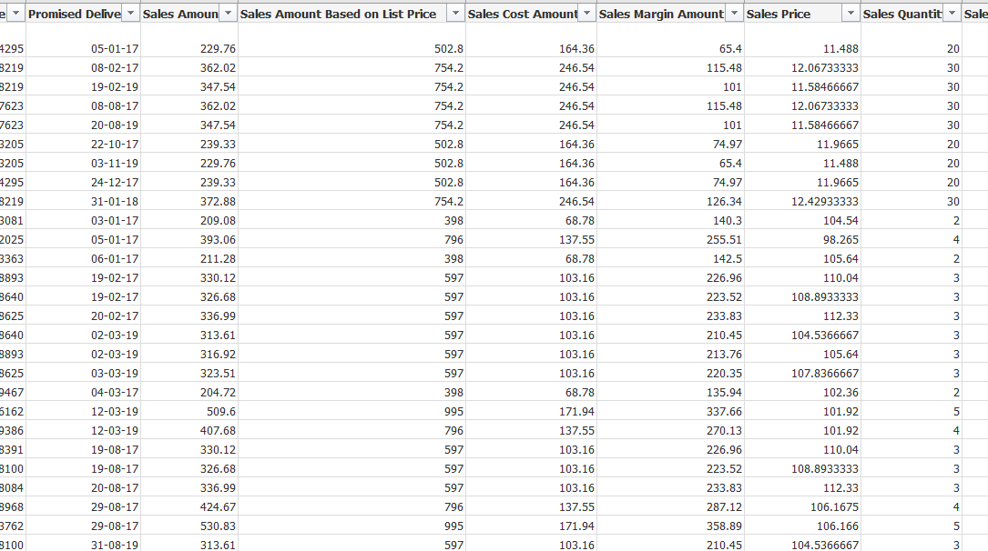
Data Preparation:
In the Preparation Process, we will convert our original datasets with other necessary attributes format.
Reconstruct the structure of the dataset.
Clean the dataset using Alteryx.
Preparing dataset: Removing blanks, dashes and column expansion.

Slide 5
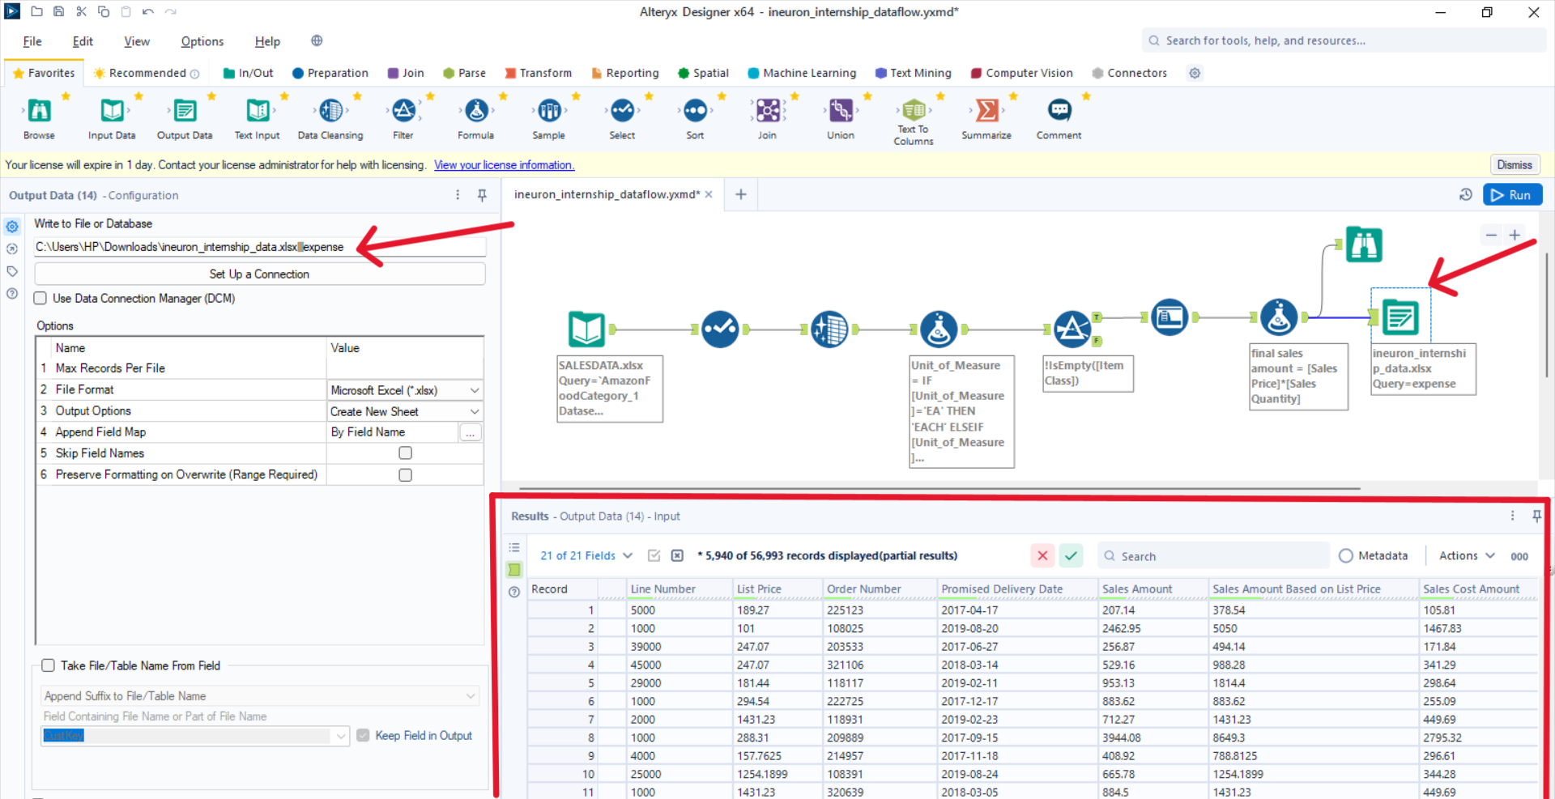
Export Data
Perform Exploratory Data Analysis Using Python:
Load Dataset
Data Preparation
EDA: Data Visualization

Slide 6




Architecture:
Data Transformation
Data Cleaning
Data Visualization
Development
Unpivoting dataset
Removing blanks and duplicated rows
Making Insightful Dashboard
Publishing
dashboard

Slide 7
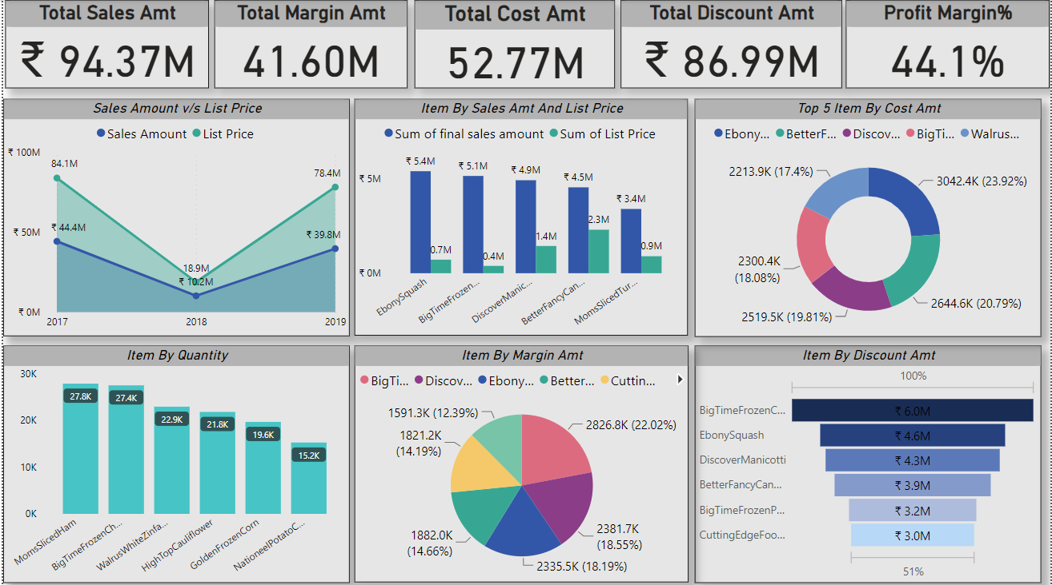
Final Dashboard:

Slide 8
Case Study:
CASE DESCRIPTION | CONCLUSIONS
Examining past expenditure records enables the identification of trends and patterns, facilitating the prediction of future costs and enhancing resource distribution efficiency. | The data analysis revealed significant interconnections between cost factors and key business variables like revenue, customer satisfaction, and employee productivity. This indicates that implementing cost management strategies that account for these connections can lead to comprehensive optimizations, positively impacting various aspects of the business.
Exploring potential interconnections between cost factors and various business variables like revenue, customer satisfaction, or employee productivity can reveal opportunities to enhance cost management strategies. | The data analysis unveiled substantial links between cost factors and crucial business variables such as revenue, customer satisfaction, and employee productivity. This underscores the importance of implementing cost management strategies that consider these connections, leading to holistic optimizations that positively influence different aspects of the business.
Efforts to reduce costs will enhance overall profitability. | Upon analyzing the data, it was observed that businesses implementing cost reduction strategies saw a concurrent rise in profitability. This reinforces the theory that adept cost management significantly enhances the bottom line.

Slide 9
Thank You!

